Slide 1
‘Whistleblowing in financial services – Is the system fit for purpose?
Presented by
Paul Carlier

Slide 2
I need to make it clear that: a) I never make an allegation or complaint unless I believe that I am right and b) I never make an allegation or complaint unless I believe that I have the evidence to demonstrate or prove it That applies to this presentation. If I am expressing an ‘opinion’ or a conclusion, then I will establish that, and the grounds and/or evidence for drawing that conclusion.

Slide 3
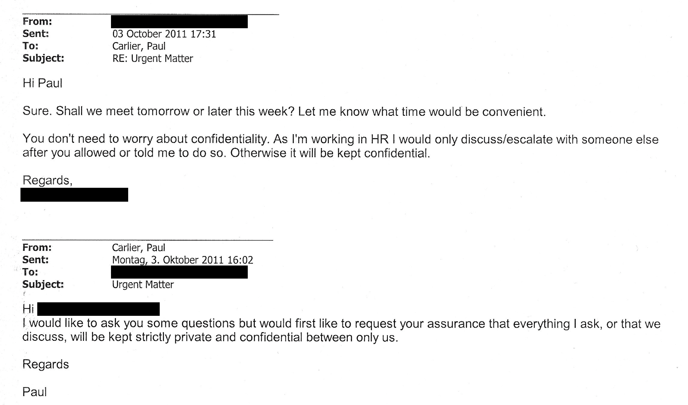

Slide 4
Within weeks of that email exchange and the subsequent ‘confidential’ meeting I was subject to a bogus dismissal ’engineered’ by…..
My line manager and Head of Global Head of FX trading to whom I had raised my disclosures….
And…….
This HR manager to whom I had escalated my disclosures.
It would later transpire that the two of them were both implicated in one of my disclosures.
You will understand therefore that subsequent to this, I had little faith or trust in the internal escalation processes….

Slide 5
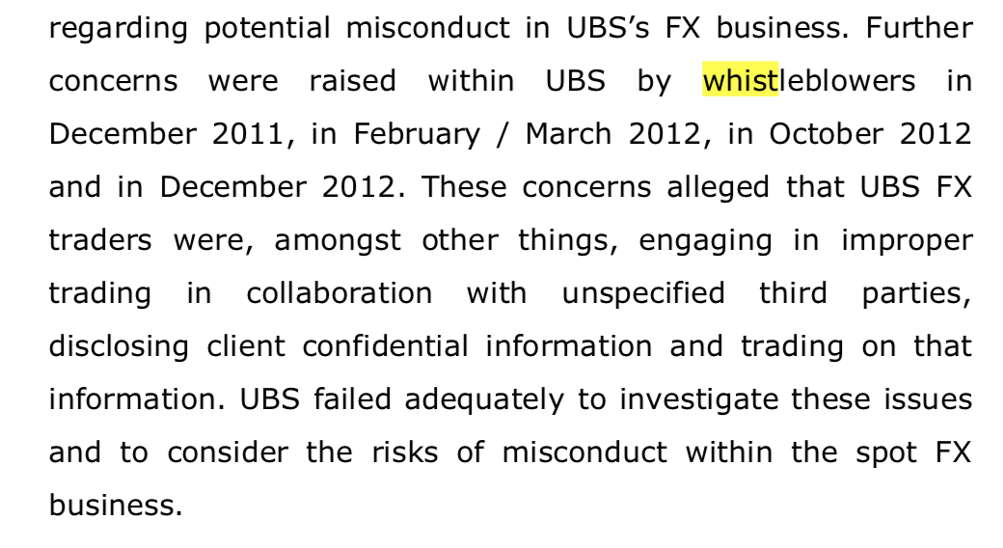

Slide 6
I joined Lloyds Banking Group (LBG) in July 2012.
I believed that given the media spotlight and the taxpayer owned status of LBG that conduct within the bank, the culture and the approach of the bank would be, for want of a better expression:
“Cleaner than clean” and with a zero tolerance for wrongdoing.
Indeed, that’s what every bank policy that was a part of the mandatory training for all employees said….. Including the whistleblower policy.
The truth and reality was altogether very different.
Between August 2012 and September 2014, I was forced to make multiple protected disclosures.
All of which I did following the whistleblower policy to the letter…..

Slide 7
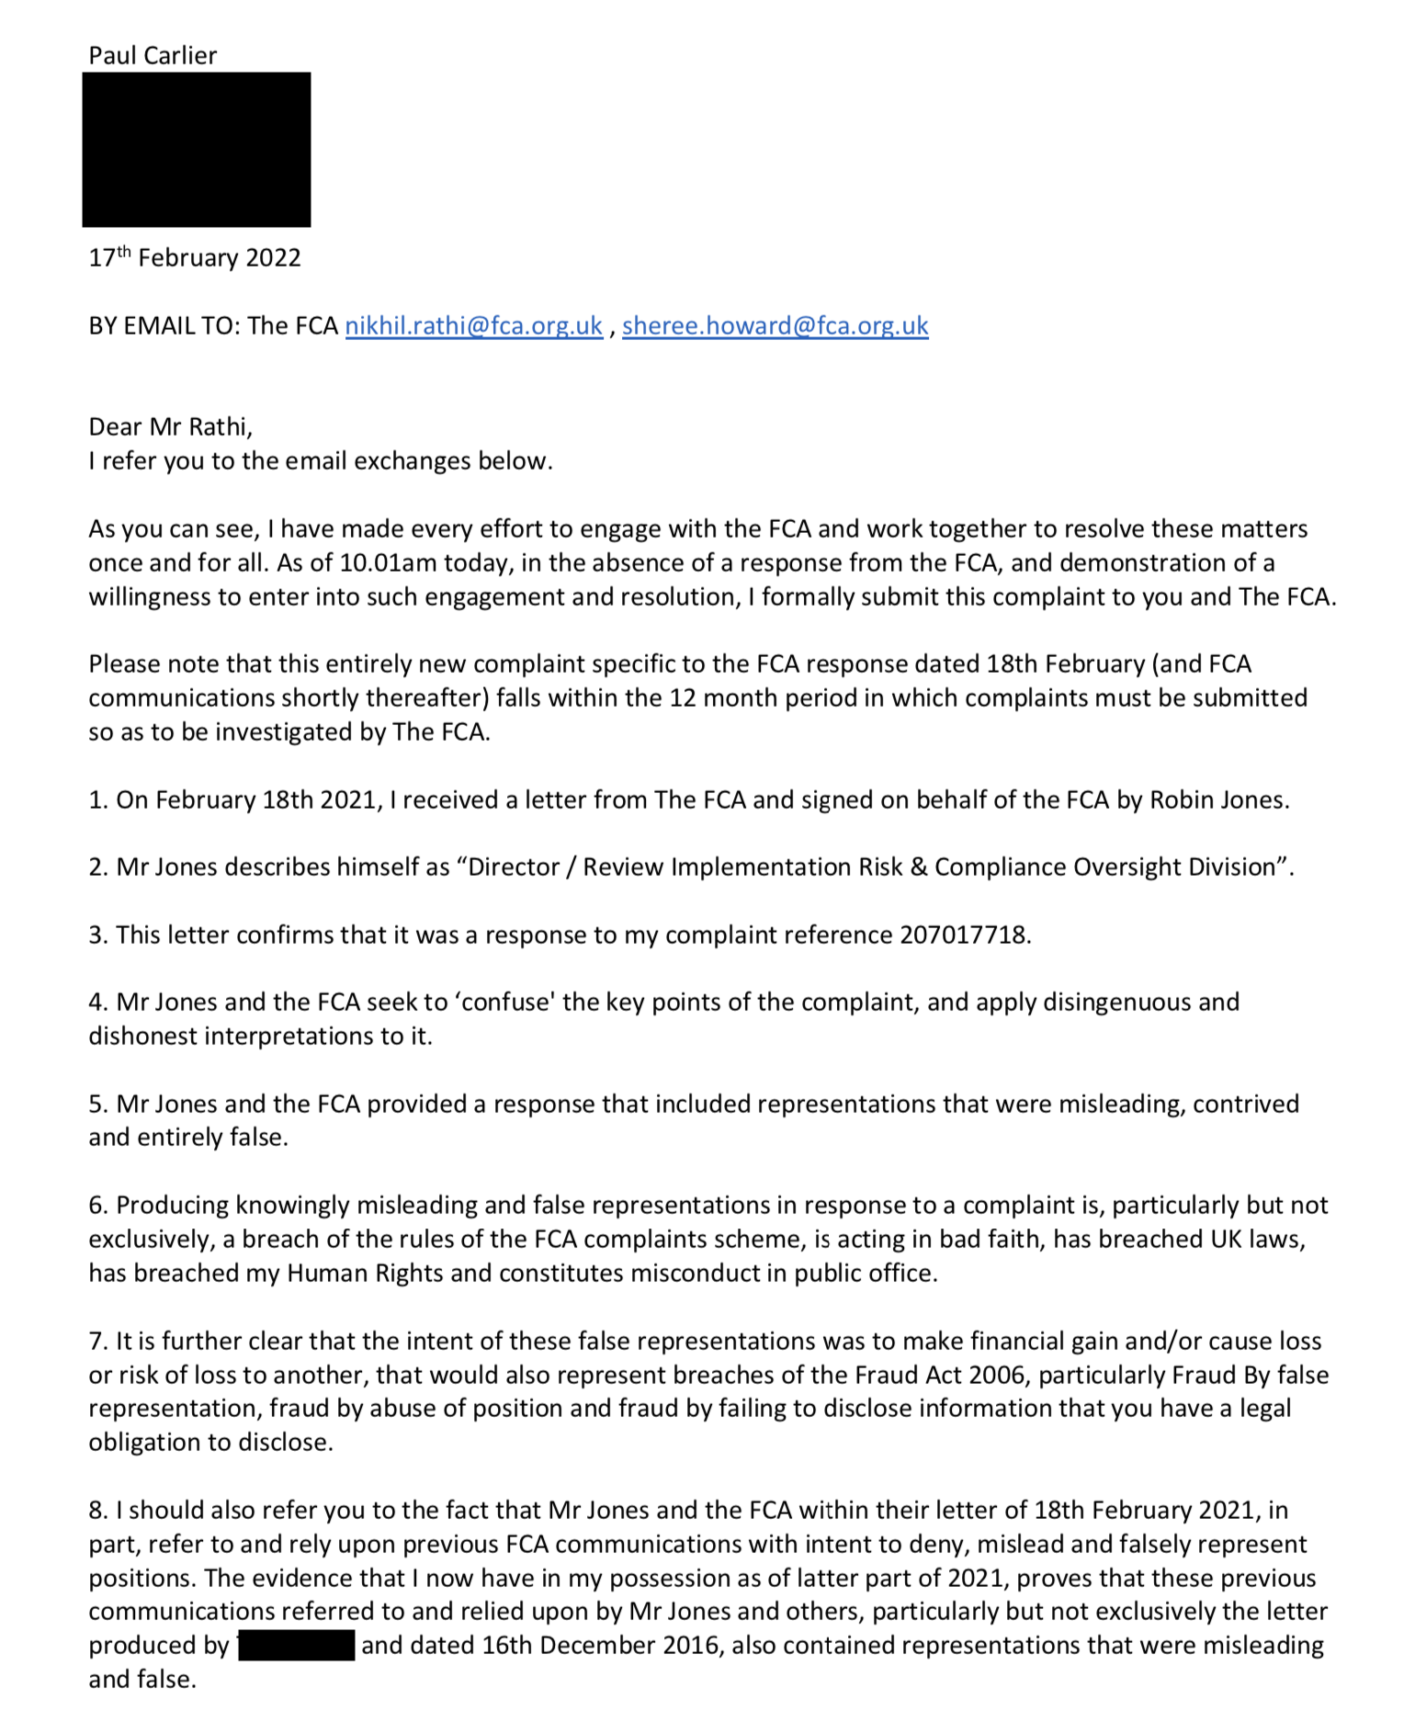

Slide 8
This evidence I now have proves:
1. Failures and/or dishonesty by the FCA whistleblower team in 2015
2. Failures and/or dishonesty by the FCA Supervsion department in 2015 and subsequently
3. Failures and/or dishonesty by the FCA GCD department in 2015, including Greg Choyce personally.
4. Failures and/or dishonesty by the FCA Complaints team of the FCA Risk & Compliance division between 2016 and 2021
5. Failures and/or dishonesty by the FCA Head of enforcement, and presumably several of those working under Mr steward, between 2016-2021.
6. Failures and/or dishonesty by the FCA CEO and multiple persons working within the CEO’s office including Andrew Bailey, Matt Brewis and Toby Hall.

Slide 9
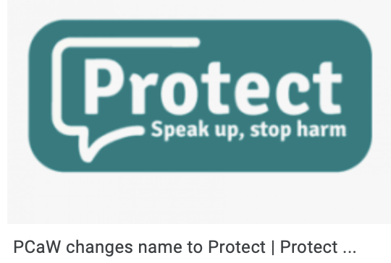

Slide 10
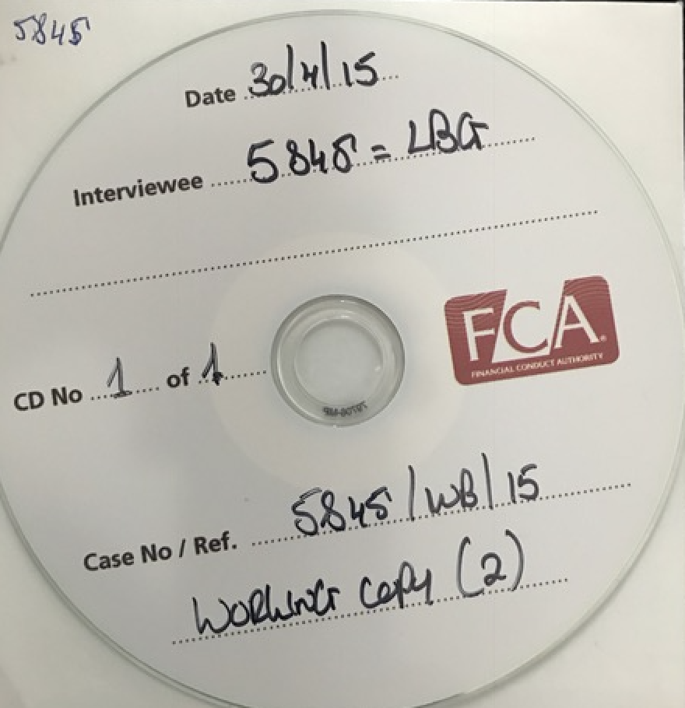

Slide 11
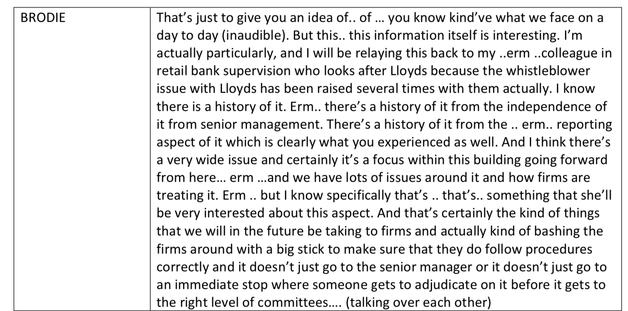

Slide 12
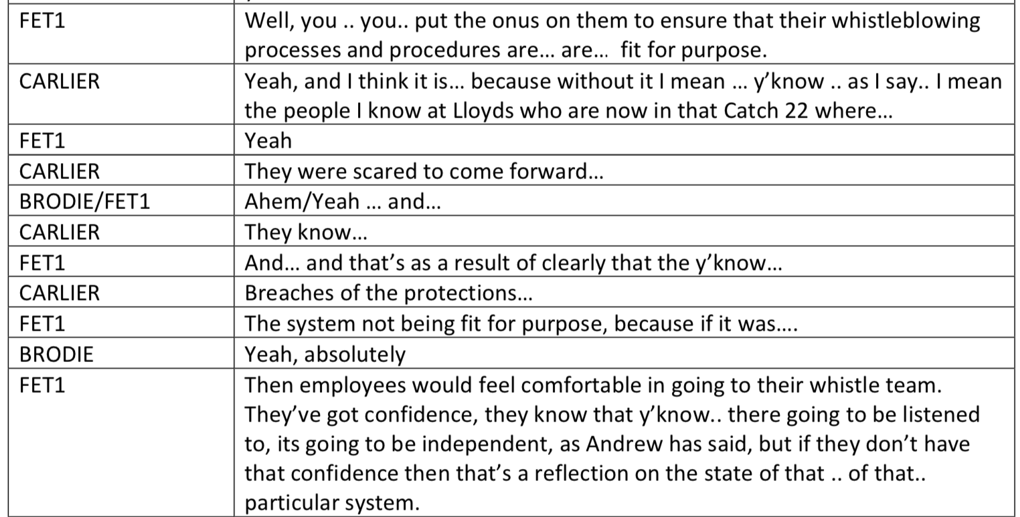

Slide 13
The FCA had therefore known that there were multiple cases where LBG had acted to the detriment of Whistleblowers, including me.
The FCA in all those cases, including mine, did…….. Nothing.
And one thing I should make VERY clear here, the FCA and LBG both now seek to claim that I was not a whistleblower. Internal FCA records show a disturbing collusion between them both on this point, that has served to alter the facts and the narrative over time. This is from a recent internal FCA memo:

Slide 14
A quite astonishing new version of the FCA’s narrative in respect to me that has been amended to suit the FCA agenda or needs.
WHEREAS:
I have written confirmation from LBG confirming that I was a whistleblower.
I have over 100 internal FCA emails spanning several years, confirming that they regarded me as a whistleblower.
I have written confirmation from PCAW (Now Protect) that they too regarded me as a whistleblower.
I was a whistleblower. I followed PIDA and the FCA/PCAW/Protect whistleblower policy to the letter.

Slide 15
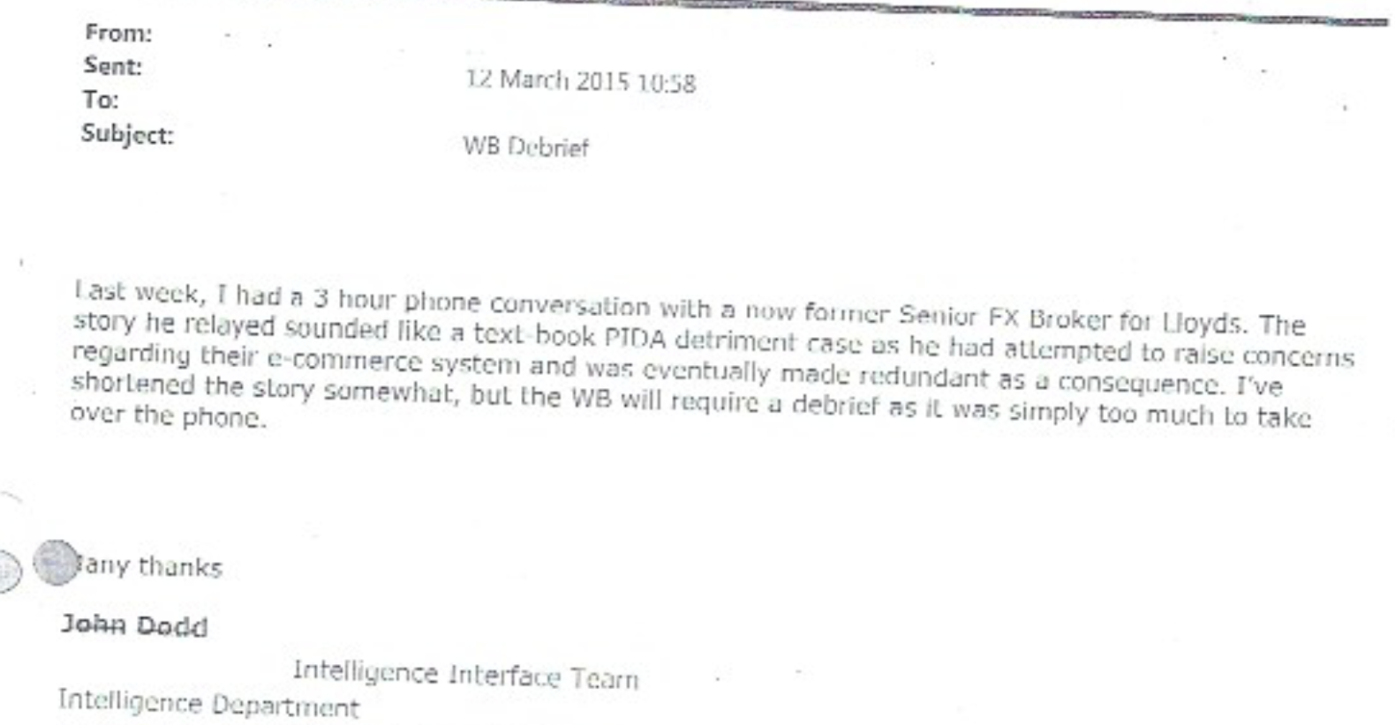

Slide 16
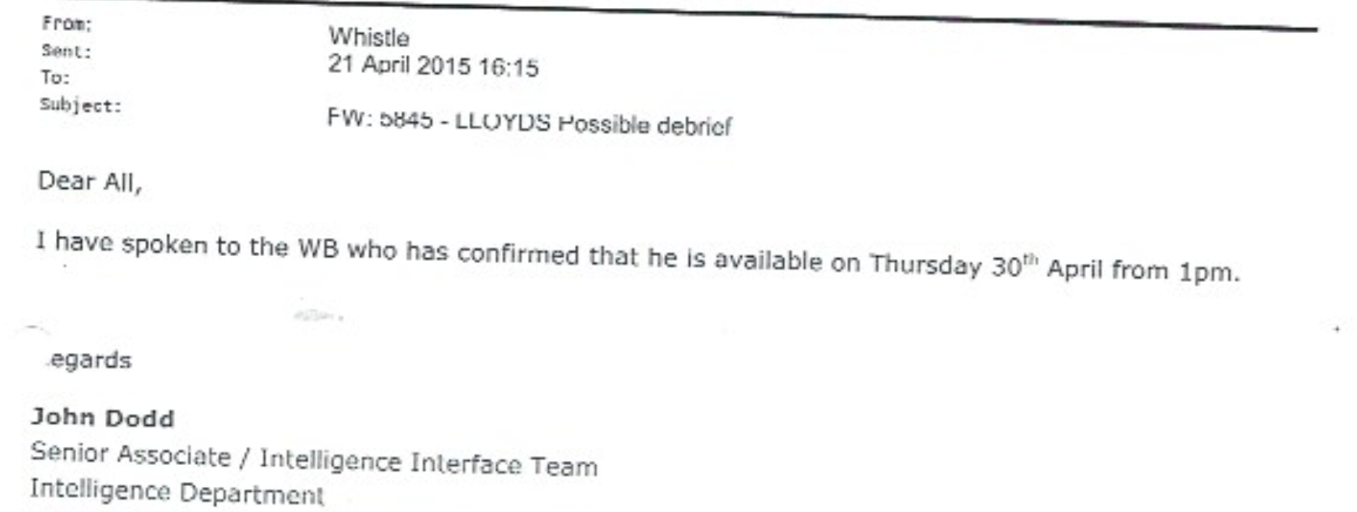

Slide 17
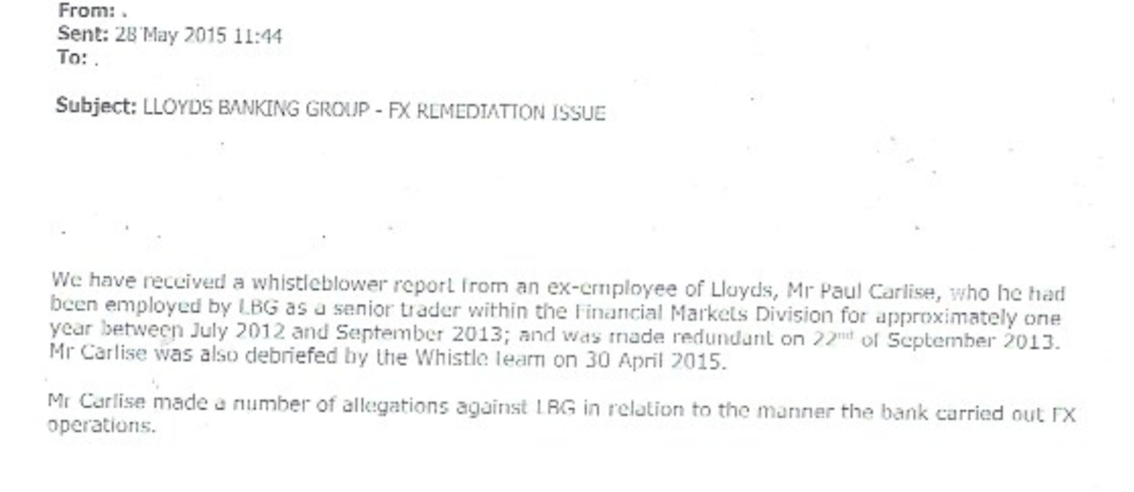

Slide 18
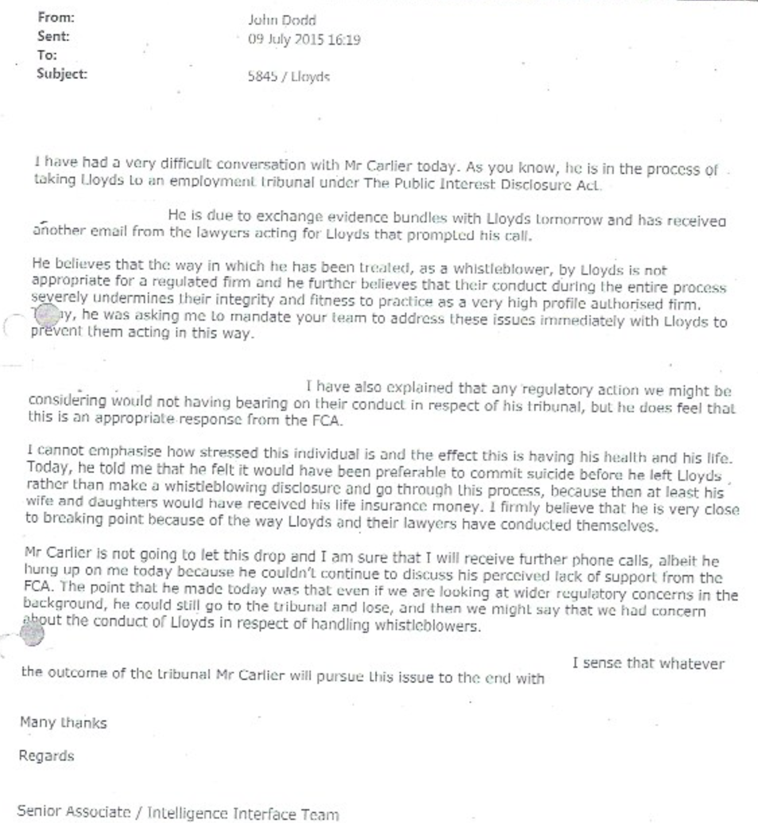

Slide 20
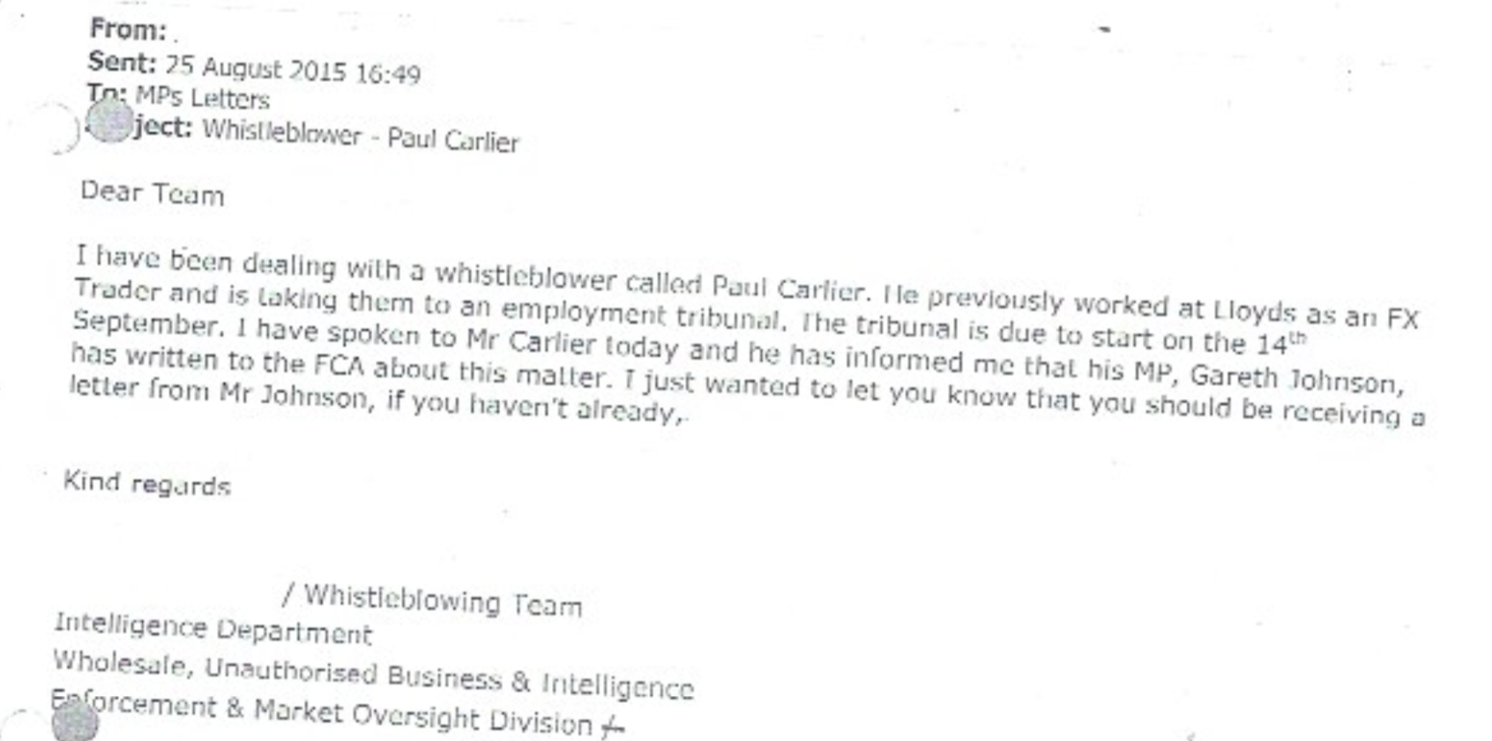

Slide 22
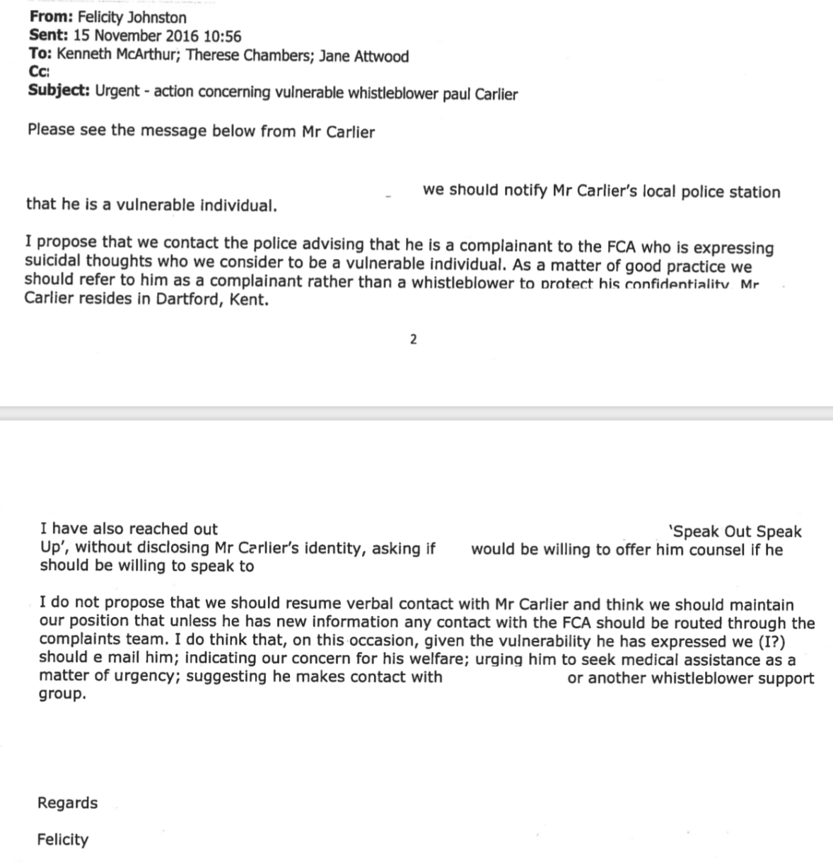

Slide 24
So, why was I denied whistleblower status
by Judge Tayler
at my Employment Tribunal?

Slide 25
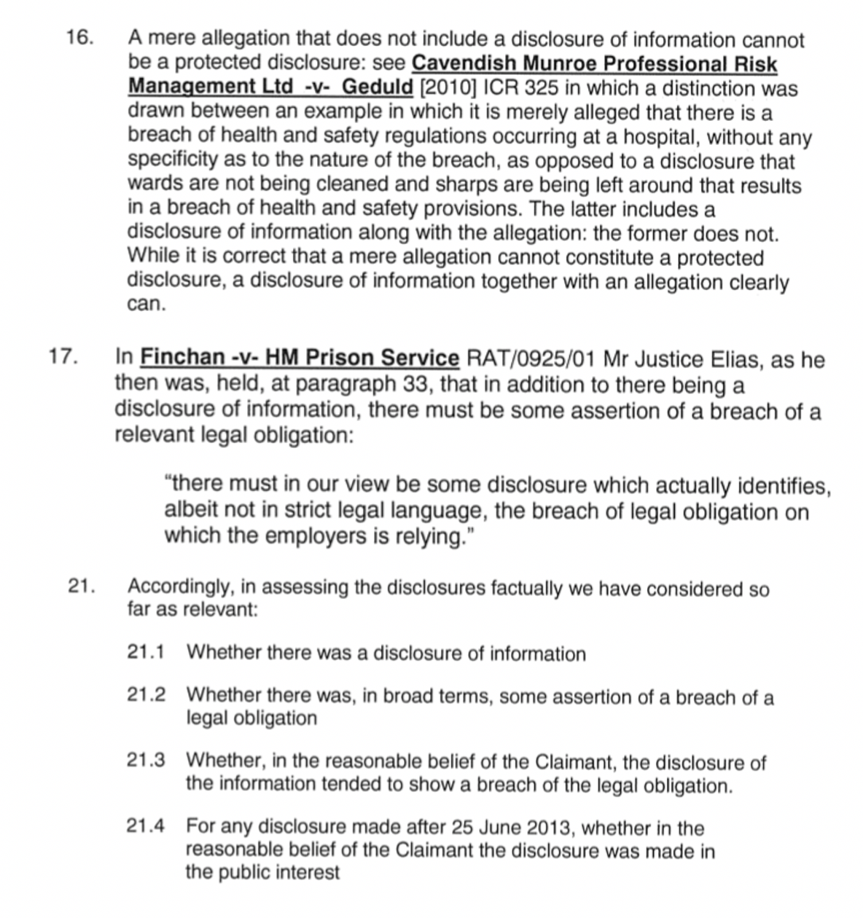

Slide 26
These Tribunal case law precedents define what must be included within a disclosure for it to qualify as a ‘Protected Whistleblower Disclosure’.
The problem is this contradicts PIDA (Public Interest Disclosure Act) and the PCAW/Protect and LBG whistleblower policy!

Slide 27
IMPORTANTLY, and I cannot stress just how important this one line is, the policies tell employees ‘HOW’ to blow the whistle;
‘Colleagues should report a concern about wrongdoing or malpractice to line management in the first instance.’
That’s the only information in the whistleblower policy as to how an employee must make their disclosures so as to ensure that they receive the protection of law.
One line, but more important and more misleading than you can possibly imagine, and the line that means that every employee at Lloyds, and every employee of a bank or firm with such a policy based upon the Protect/PCAW model policy has no protection under law whatsoever.
Why? Because of that Employment Tribunal case law that demands the disclosure be made in a specific fashion, and what it MUST include.

Slide 28
- The Lloyds whistleblower policy itself and the fact that it:
a) Misleads all employees by stating that it is consistent with all applicable laws (PIDA is the only applicable)
b) Misleads all employees by stating that they are afforded protection under said policy
c) Misleads all employees by detailing precisely what employees are obliged to do; Simply ‘Raise a concern’ if you see conduct that breaches UK laws, regulatory codes or Lloyds own policies
d) Misleads all employees by stating that it is sufficient to raise these concerns with your line manager or other senior manager
I followed this to the letter as I was trained by Lloyds to do.
They then argued, only in the closing arguments rather than during the hearing so that it could not be contested by me, and produced precedent after precedent to support, that my disclosures were not protected disclosures in the first instance because I had not made them in the correct fashion, or had not made specific enough allegations etc etc.
Essentially, they trained me to blow the whistle in a manner that they knew was NOT consistent with all applicable laws, that they knew did NOT afford any protection to employees whatsoever, and that they knew would guarantee them a win in the event that any employee brought a whistleblower case to Tribunal or Court.
Their argument at the Tribunal was contrary to that contained in their own whistleblower policy.

Slide 29
Your approach and understanding appears to be to provide comfort and encouragement to such people so that they come forward, and without regard for their wellbeing if they do.
This is utterly wrong.
This is knowingly creating the illusion to millions of employees that they have protection if they follow these policies as written, which most will do rather than call for advice, because these policies:
- State that they are consistent with relevant law
- State that employees have protection by law against retaliation or other detriment
- State clearly how they should blow the whistle so as to ensure said protection.
Every employee that blows the whistle faces the very real prospect of losing everything as you well know. So, your policy MUST first and foremost protect that employee and mitigate against EVERY possible detriment that they might suffer, and if it has to be legalistic then so be it.
Your model policy is misleading millions of employees and leaving them vulnerable.
However, worst of all is that they will trust the policy because of PCAW’s (now Protect) supposed standing in respect to whistleblower law, and therefore you are knowingly leading them down the path whereby they will, without knowing it, be gambling their entire livelihood and the futures of their family and with little or no chance of justice should they need to avail themselves of the legal system.
The policy doesn't have to tell you how to sue if you suffer detriment, but it should tell you precisely what to do according to case law so that in the event that you do have to sue, you have not already prejudiced your case and guaranteed a defeat!!

Slide 31
Liz Gardiner CEO of Protect (Formerly PCAW)
“We decided that, three years after the new whistleblowing rules were implemented by the financial regulators in 2016, it was time to revisit the sector and once again scrutinise the data to see what difference, if any, those rules made. Was it easier now to be a whistleblower? Were they better treated? Had the rules on employers made a difference to workplace culture in the City?
Our findings were revealing. We identified some real changes from our first Silence in The City report – with much more awareness and trust by employees in the internal whistleblowing arrangements put in place by employers.
But we also found much to suggest that the changes are only cosmetic. While our sample are whistleblowers who have self-identified as in need of advice - we were shocked to find that still 7 in 10 of those raising concerns were victimised for doing so and a third reported that their concerns were ignored.”

Slide 32
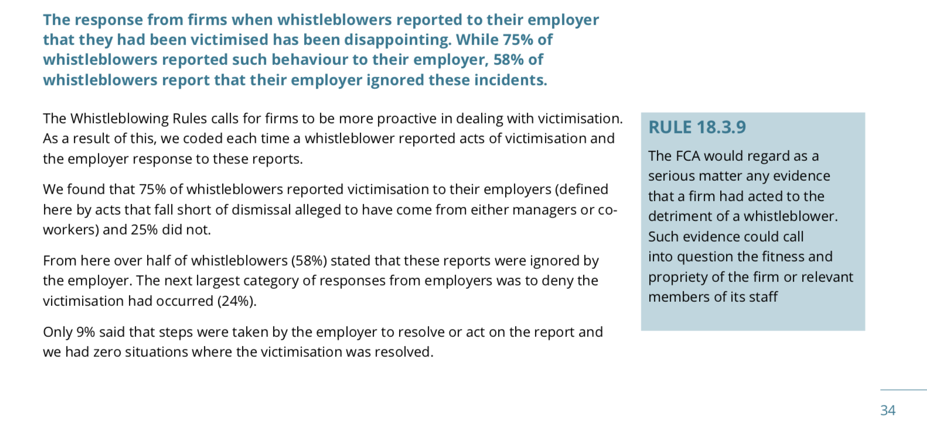

Slide 33
Why is the CEO of PCAW/Protect ‘shocked’?

Slide 34
On 10 Jan 2017, at 10:45, xxxxx xxxxx xx@pcaw.org.uk wrote:
Hi Paul
I have attached our model policy, the principles and wording of which have remained the same for many years. The language used is deliberately non-legalistic but is in compliance with the law. Many organisations have amended it to suit their own models over the years. We don't have 'sign off' on any organisations own policy.

Slide 35
From: Paul Carlier <paul.carlier@live.co.uk> Sent: 16 January 2017 18:43 To: xxxxxxxxxxxxxxxx Subject: Re: Lloyds Whistleblower Policy 2014
Hi xxxxxxxxxxx,
Thank you for your response and provision of the model policy.
I have several concerns regarding this.
1. It is not compliant with the law at all. It might well be compliant with PIDA as written in to legislation, but it is far from consistent with case law. And it is case law that trumps all when it comes to a Court of law or the Employment Tribunal. I have learned this the hard way by way of my tribunal judgement.
2. To be deliberately non-legalistic staggers me. It is supposed to represent the law, the compliance with and upholding of, is entirely a ‘Legal’ matter, by definition it MUST be legalistic. Whilst it does not neccessarily have to be framed in legal jargon, what is written must reflect the legal requirements.
FOR EXAMPLE:
It is not difficult to explain in said policy that which you must do, and this which your disclosure must specify and contain as determined by case law to ensure protection by PIDA. One paragraph was all that is required. Simply saying that you must ‘raise a concern’ is utterly inadequate and actually false in respect to case law.
3. Lloyds Whistleblower Policy adopts the same framework as your model and reccommended policy. Given PCAW’s prominence in the UK in respect to whistleblowing I imagine that numerous others do the same.
4. Your model policy states:
Please remember that you do not need to have firm evidence of malpractice before raising a concern. However we do ask that you explain as fully as you can the information or circumstances that gave rise to your concern.
That is not what the Judge at my Employment Tribunal ruled.
I followed the Lloyds Whistleblower Policy to the letter. A policy that is based upon your model policy. A policy that states it is consistent with applicable law (the only one is PIDA). A policy that tells employees what their obligations are. A policy that tells employees how they should blow the whistle; namely ‘Raise a concern with your line manager or other senior manager…’. I did exactly that.

Slide 36
Yet the Judge ruled that NONE, I repeat ‘NONE’ of my disclosures qualified as protected disclosures as a result of the case law precedents that Lloyds themselves raised in closing arguments.
They argued that I had not blown the whistle correctly. They effectively argued that their own policy was garbage and a fraud.
The principle of the policy should be to ensure that all employees subject to these policies receive the proper protection that PIDA is supposed to offer.
All this policy does is:
a) Mislead employees in to believing that they have any protection by law
and
b) Guarantee the employers that use this model a victory in Court or at the ET should an employee dare to blow the whistle and get screwed by their employer as a result.
Regards
Paul Carlier

Slide 37
From: Cathy James <cj@pcaw.org.uk> Date: 24 February 2017 at 09:27:17 GMT To: <paul.carlier@jupiter87.com> Cc: xxxxxxxxxxxx <xxxxxx@pcaw.org.uk> Subject: Fwd: Re: Lloyds Whistleblower Policy 2014
Dear Mr Carlier, My apologies for the delay in responding to this email. As explained by xxxxxxxxxx, we have considered the points raised in your email. As you are aware we work very hard with staff and businesses to try to ensure that public interest concerns are raised effectively and handled in such a way that the individual is not treated badly in the process. Our model policy is a fundamental part of this approach, it is a document aimed at staff to inform them about how to raise concerns simply and effectively. It should also set out how a concern is to be handled and make assurances from the organisation about taking the concern seriously, protecting confidentiality where requested and taking a zero-tolerance approach to reprisals.
This is a widely accepted approach across HR policies - eg. an equality policy does not set out in detail how an individual can sue for discrimination, rather it is a commitment from the organisation to treat staff fairly. The same principle applies with a whistleblowing policy.
Our work in ensuring whistleblowing works means that the law (which is a mechanism for seeking compensation when things have gone wrong) is not the driving force for the messaging in the model policy. It is a complex piece of legislation to explain well in one document and an anxious whistleblower could easily be put off by an overly legalistic policy, meaning a culture of silence prevails. And please bear in mind that we encourage every policy to clearly include us as an early source of advice, at which point one of our legally trained advisers could explain PIDA fully and how best to make a disclosure which falls within the scope of the law.
I appreciate that this is not the approach that you consider appropriate given your experiences and you are of course entitled to your view, but we hope you will understand that our approach has been developed over a number of years and is a practical response to a complex problem. I would be happy to discuss matters with you if this is of interest. Do contact me on the number below to discuss matter further. Yours sincerely
Cathy James Chief Executive

Slide 38
From: Paul Carlier <paul.carlier@live.co.uk>
Subject: Re: Lloyds Whistleblower Policy 2014
Date: 24 February 2017 at 10:57:29 GMT
To: "cj@pcaw.org.uk" <cj@pcaw.org.uk>
Cc: xxxxxxxxxxxxxxxxxxx
Ms James,
I really do not believe the problem is as complex as you believe it to be. The complexity exists as a result of the failure to ensure that Whistleblower Policies are consistent with case law and do offer the protection that they claim to.
After all, a Whistleblower Policy is, first and foremost, there to help and to protect the individual that finds themselves in a position where they feel the need to, or are obliged/forced, to blow the whistle.
Whereas you claim that the law is not and should not be the driving force behind whistleblower policies. That is, frankly, appalling!
A policy that is there to ensure the rights of employees are protected MUST have, as its entire premise, the law and specifically case law as its foundation. Without it, there is no protection for employees and all it does is serve the interests of the firms that can then screw their employees whilst knowing absolutely, as Lloyds clearly did, that they have a guaranteed victory should it come to tribunal.
In EVERY case where an employee's rights are breached, they will need to call upon the legal system to resolve, and in the legal system, correct me if I am wrong, the law and case law is everything, so your model policy ensures that they are screwed when they do, and were screwed before they even made their disclosure.
Your approach and understanding appears to be to provide comfort and encouragement to such people so that they come forward, and without regard for their wellbeing if they do.
This is utterly wrong.

Slide 39
This is knowingly creating the illusion to millions of employees that they have protection if they follow these policies as written, which most will do rather than call for advice, because these policies:
- State that they are consistent with relevant law
- State that employees have protection by law against retaliation or other detriment
- State clearly how they should blow the whistle so as to ensure said protection.
The Lloyds policy is based upon your model policy and was devised with significant input from PCAW.
Why would you call for advice when the policies are so explicit.
FYI though, when I did call and explain the disclosures that I had made, PCAW accepted that I had made protected disclosures. Never once did you dispute or warn me otherwise.
You claim that PCAW has developed this approach over a number of years. Well, this years of experience will mean that you know the position every employee is put in when they witness or suspect wrongdoing. It's a LOSE/LOSE:
- Stay quiet and don't speak up, then face the consequences if it is discovered that you knew and said nothing
or
- Speak up and risk retaliation or detriment in numerous ways be it direct and obvious retaliation, discreet but sinister retaliation and victimisation and your alienation within the work place if indeed you manage to retain your job.
Every employee that blows the whistle faces the very real prospect of losing everything as you well know. So, your policy MUST first and foremost protect that employee and mitigate against EVERY possible detriment that they might suffer, and if it has to be legalistic then so be it.

Slide 40
Your model policy is misleading millions of employees and leaving them vulnerable. However, worst of all is that they will trust the policy because of PCAW's supposed standing in respect to whistleblower law, and therefore you are knowingly leading them down the path whereby they will, without knowing it, be gambling their entire livelihood and the futures of their family and with little or no chance of justice should they need to avail themselves of the legal system.
The policy doesn't have to tell you how to sue if you suffer detriment, but it should tell you precisely what to do according to case law so that in the event that you do have to sue, you have not already prejudiced your case and guaranteed a defeat!!
Finally, can you please advise just what action you have taken against Lloyds or what discussion that you have had with Lloyds over my case and their treatment of me as a whistleblower?
Let's not forget that Lloyds themselves, via their whistleblower and Group Fraud teams, identified several concerns that I had raised prior to my redundancy that they believed quaalified for investigation by the Group Fraud team. IN SO DOING THEY CONFIRMED THAT THESE WERE PROTECTED DISCLOSURES.
Only for Lloyds to then argue in closing arguments only that my disclosures were not protected because I had not made them in the correct way (DESPITE FOLLOWING THEIR POLICY TO THE LETTER) according to case law.
I trust that you have addressed their wrongdoing in this respect?
Paul Carlier

Slide 41
I made this statement to both the FCA and PCAW in 2016 and 2017
“In other words, misleading employees in to becoming lambs to the slaughter due to the illusion of protection that PCAW and the firms knew didn’t exist if employees followed the policy.”
So, I ask again, why is the CEO of Protect so shocked to find that exactly this was happening four years after I warned them and the FCA that exactly his would happen?

Slide 42
I raised these concerns with the FCA, with the TSC and with Protect.
No engagement and only avoidance.
I therefore raised these concerns publicly, and those specific to PCAW/Protect.
I remind you that ‘Protect’s’ tagline is:
“Speak Up, Stop Harm”

